Slide 1
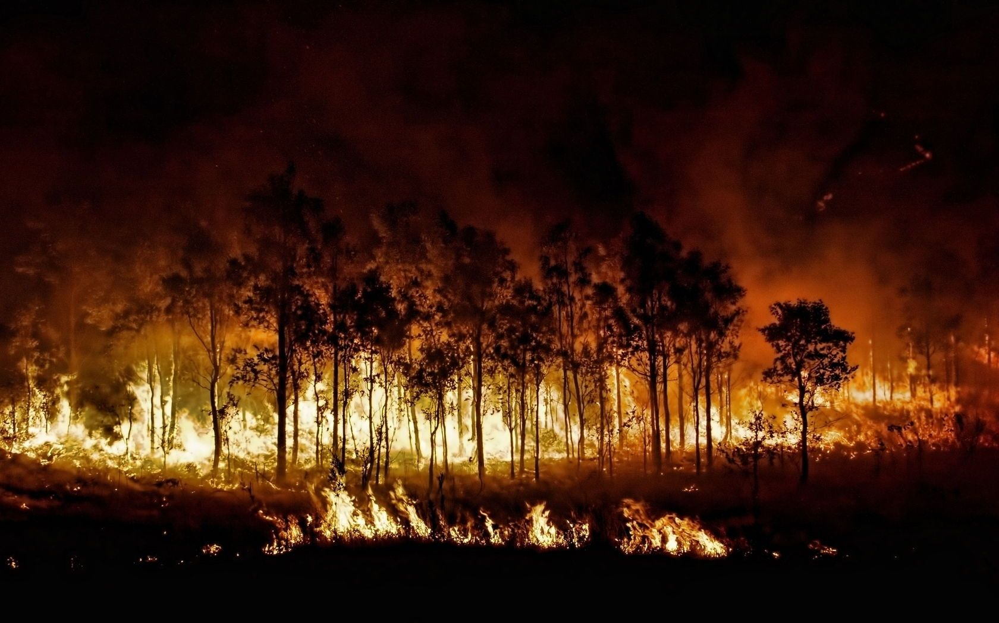
Yes, Wildfires cause Global Harm.
Pratik Teredesai
Gurmanjit Singh Sahni
Mohit Asija
Guided By: Prof. Shahid

Slide 2
Why Wildfires ?
90% of all wildfires are started by humans.
An average of 1.2 million acres of US woodland burn every year.
It takes an average of 2-4 years after a wildfire before reforestation efforts can begin.
Climate change, as predicted, is fueling longer, stronger, and quicker-to-start wildfires.

Slide 3
Problem Statement
Wildfires have become a major concern in the recent past which had a huge impact on both the environment and the living beings as well.
There have been numerous wildfires that go un-noticed only the major ones get the media coverage.
It would be a major to predict the same with frequency or consistency.
The predictions stays the most important step in the Project.

Slide 4
Analytical Problem
Our motive through this project is to overcome, predict and map the counties which are prone to wildfires.
The Dataset Consists of 31 Attributes
1.88m Rows
Geo-Spatial Data

Slide 5
Dataset
Its an open database available by U.S. Govt.
The Dataset Consists of 31 Attributes
1.88m Rows
Geo-Spatial Data
Timestamps
Various fire codes

Slide 6
Challenges
Connecting SQLite to Python
Extraction of whole data into .Csv

Slide 7
Data Driven Insights
Cleaning at the initial stage
Using models such as
Decision Treees
Gradient Boosting
Random Forest
Tableau for Visualizations

Slide 8
How will this help society
Educating people regarding harm caused by wildfires and controlled use of campsites
Prediction of Wildfires limiting the inhabitation of humans near fire prone areas
Improving Air Quality and Carbon Footprint in the long run

Slide 9
Thank You
References

